Slide 1
Introduction to Python
Programming with Data
CEIS110 September 2022
Christopher Hill
Professor Kim

Slide 2
Introduction
Data grows exponentially (digitally congruent to Moore’s law)
This project used a governmental cloud-based source to gather temperature and humidity data in my area
The sourced data is analyzed and processed with programmed data analytics

Slide 3
Software Inventory
To begin developing this project, necessary software was required
Anaconda (including Spyder Python IDE and others), Microsoft Excel, and JupyterLab
I also used a live response website for double checking code functions: https://www.programiz.com/python-programming/online-compiler/

Slide 4
Flowchart
Start
Install Python Modules
Include the following processes:
Install python
Download weather data to a database.
Extract weather data from database into a comma separated file with python
Cleanse weather data
Use Excel to manipulate data
Use python data analytics modules to develop graphical models
Download Weather Data to a Database
Extract Weather Data into CSV
Cleanse Weather Data
Use MS Excel to Manipulate Data
Use Python Data Analytics Modules to Develop Graphical Models
End

Slide 5
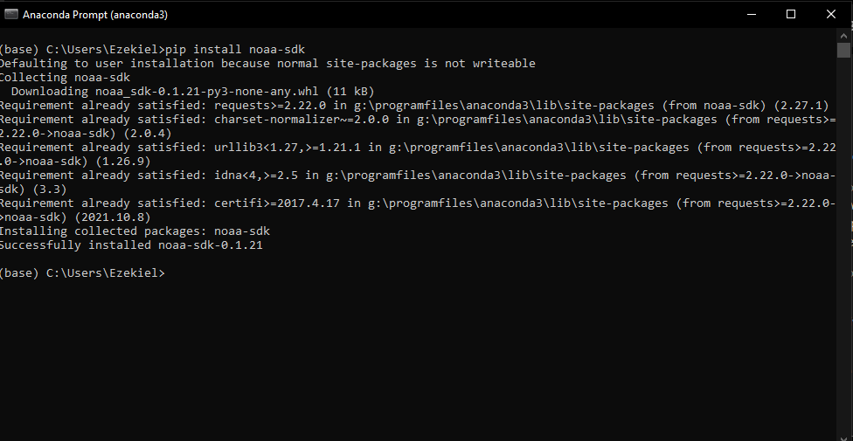
Adding Library (Screenshot)
Include screenshot of NOAA-SDK library installed.
Ensure result "Successfully installed noaa-sdk" of pip install command is visible in your screenshot.

Slide 6
Gathering Temp and Humidity Data
After planning and design, the developed code was set to download local weather observations
The downloaded data was stored in a CSV for personal analysis

Slide 7
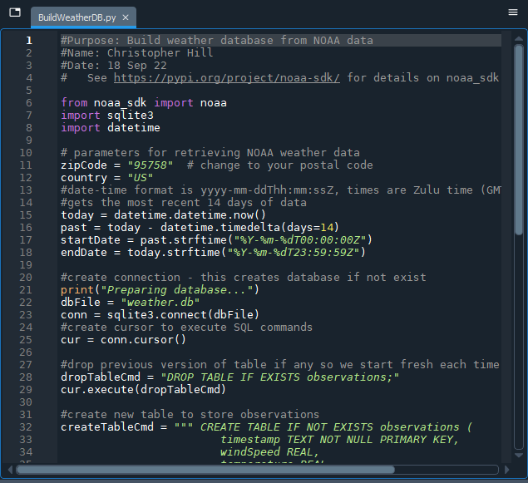
BuildWeatherDb.py Code (Screenshot)
Screenshot of code in Spyder
Must have your name and date in comments
Must have your zip code

Slide 8
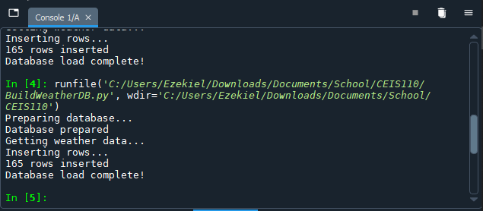
Python Console (Screenshot)
Screenshot of program output in Python console showing program executed successfully

Slide 9

Weather.db File (Screenshot)
Screenshot of Windows Explorer showing database file Weather.db was created

Slide 10
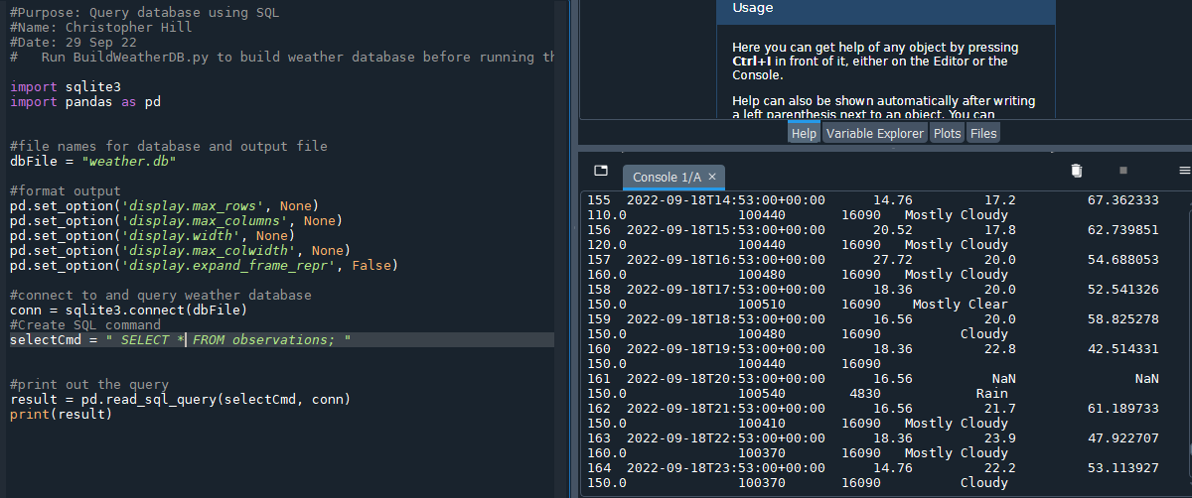
Query to retrieve all columns and all rows (Screenshot)
Screenshot of SQL query command and results

Slide 11
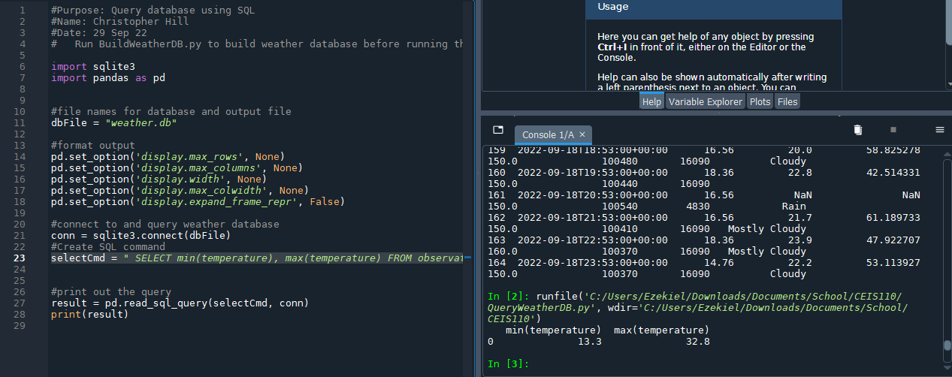
Query to retrieve lowest and highest temperatures
Screenshot of SQL query command and results

Slide 12
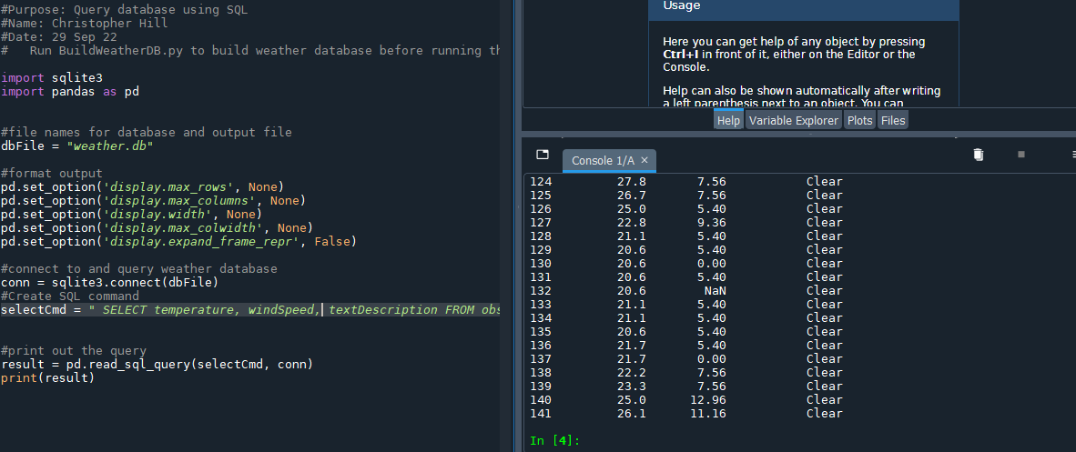
Query to retrieve all clear days
Screenshot of SQL query command and results

Slide 13
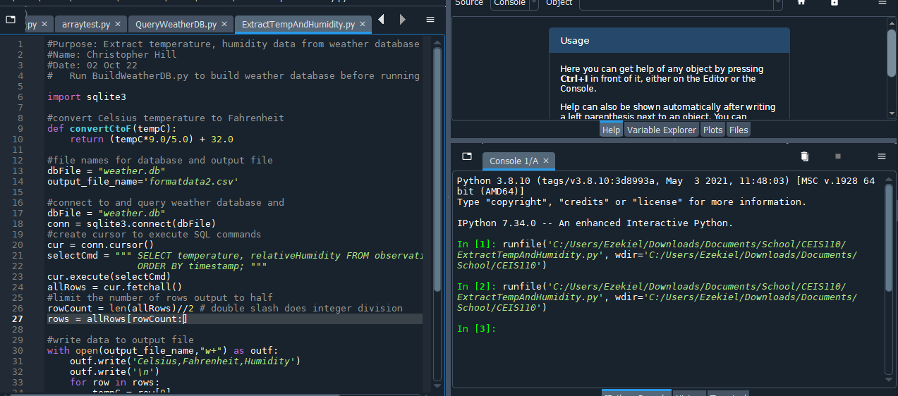
Python code
ExtractTempHumidity.py Python code with your name and date in comments

Slide 14
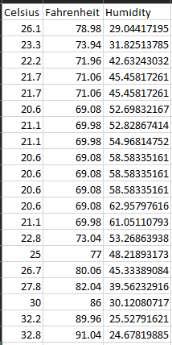
Retrieve and Convert Data to CSV Format
Formatdata file open in Excel showing 3 columns of data

Slide 15
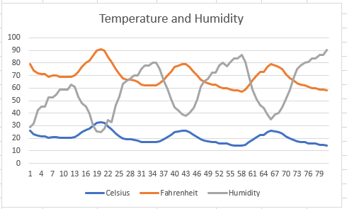
Temperature and Humidity Chart
Excel chart based on temperature and humidity data from database

Slide 16
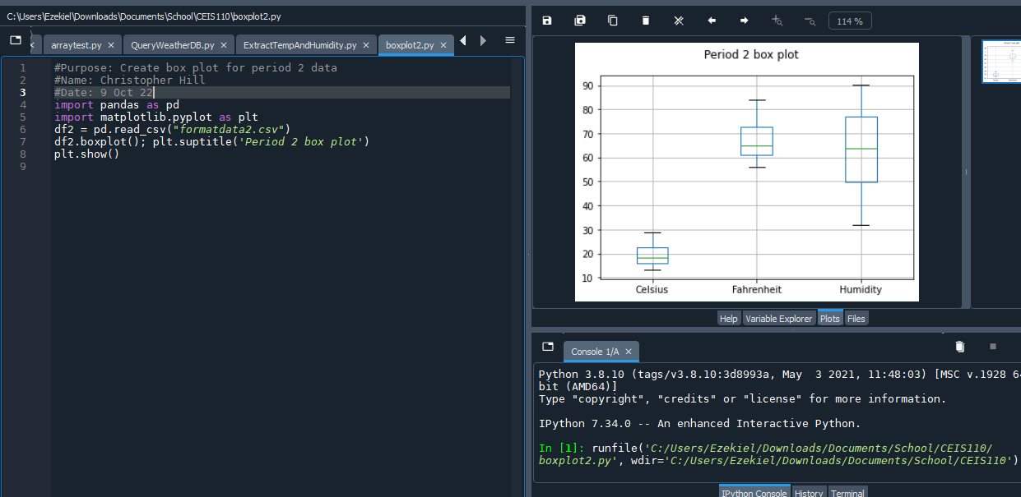
Plot #1
Plot and code used to generate it
Box
Line
Histogram
Scatter
Research your own!

Slide 17
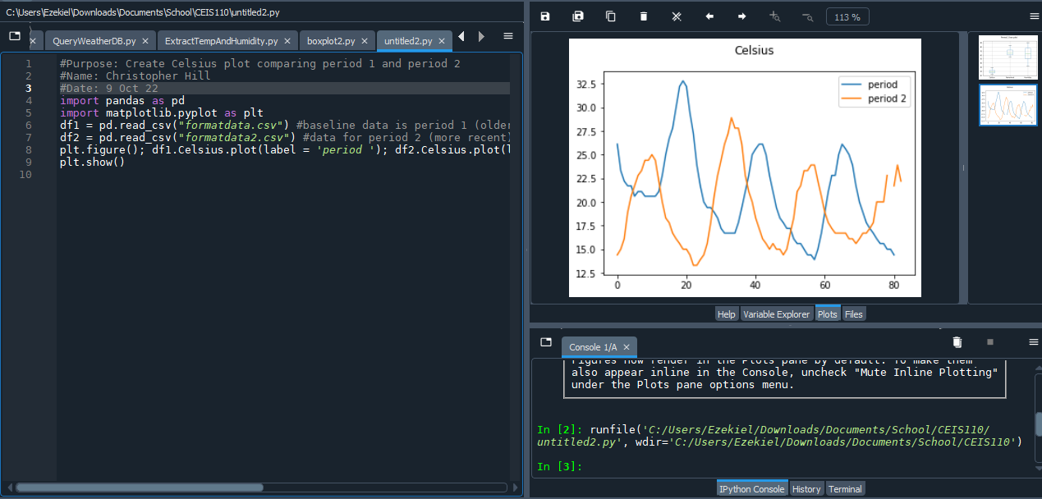
Plot #2
Plot and code used to generate it
Box
Line
Histogram
Scatter
Research your own!

Slide 18
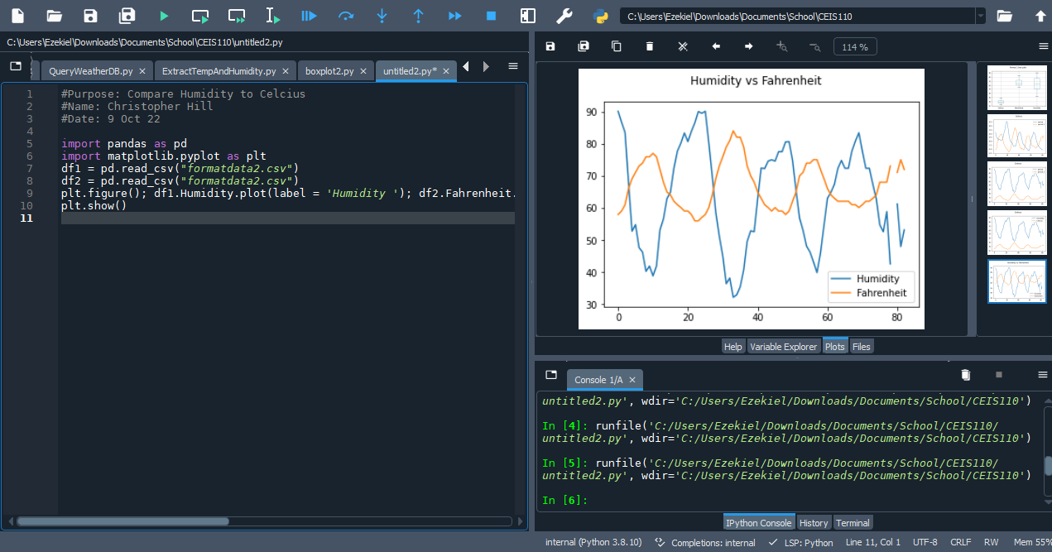
Analysis
Think of your own question and create a chart/graph to answer it
Your own question: Is humidity lower when temperature is higher?
Answer supported by Chart: Yes.

Slide 19
Prediction
Develop a prediction based on the data. What variations in temperature and humidity do you expect over the next few hours or days? How would humidity change if temperature goes up or down?
As temperature rises, humidity falls. As temperature falls, humidity rises.

Slide 20
Challenges
Mental differentiation from other language syntax
Ironically, the simplicity of Python’s forgiveness of syntax and structure made coding initially more difficult with my prior knowledge of other languages

Slide 21
Conclusion
This project covered fundamental ideas and abilities within the Python coding language
ITProTV was an invaluable tool and resource for becoming familiar with Python
GitHub: https://github.com/ZDiezel/SchoolProjects

